Slide 1


Improve Your Productivity with Roslyn Analyzers
Mika Dumont
@mika_dumont
Kendra Havens
@gotheap

Slide 2
Visual Studio 2019 16.8 GA and 16.9 Preview
Dev environments in the cloud
.NET productivity
GitHub Codespaces available as a limited “preview” for ASP.NET Core, .NET Core and C++
Roslyn analyzers are now included in the .NET 5.0 SDK
.NET Code Style analyzers can now be enforced on build ^{Preview}
AI-assisted productivity
Linux diagnostics
Team Completions: Get C# contextual suggestions for your own types, through custom models shared with your team
.NET Core Debugging with WSL 2 using the Linux distro of your choice ^{Preview}
Debug managed Linux core dump
Automated CI/CD workflow ^{Preview}
XAML productivity
GitHub Actions workflow from within Visual Studio for your .NET Core apps
XAML Binding Failures diagnostic improvements
XAML Hot Reload supports UWP
Git workflows
Easily execute your daily Git operations using the Git Changes window
Browse and manage your Git repository and stop worrying about merge conflicts
visualstudio.com/download aka.ms/vs-preview
Notes:
Productivity
Roslyn analyzers are now included in the .NET 5 SDK
IntelliSense completion for DateTime and TimeSpan
Inline parameter name hints
With Intellicode team completions, you can train a custom model on your C# codebase & get starred contextual completion suggestions for your own types.
New Git experience
Quickly access your Git shortcuts with a new Git menu
Easily execute your daily Git operations using the Git Changes window
Fluidly browse and manage your Git repository and stop worrying about merge conflicts
Linux Debugging
Debug managed Linux core dump directly in Visual Studio
.NET Core Debugging with WSL 2 using the Linux distro of your choice (Preview)
XAML experience
XAML Binding Failures diagnostic improvements
XAML Hot Reload supports UWP
GitHub Actions (Preview)
- Generate a GitHub Actions workflow from within Visual Studio for your ASP.NET Core apps

Slide 3
Agenda
Roslyn overview
.NET 5.0 SDK Analyzers
How to write a Roslyn Analyzer

Slide 4

What is Roslyn?

Slide 5
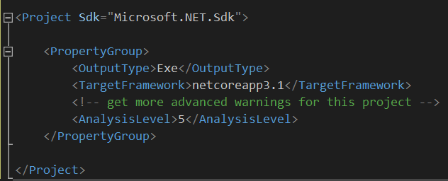
Analysis Levels
Use when you need them
You can use .NET 5 analyzers even with projects that target an earlier framework
Target Framework | Default Analysis Level
net5.0 | 5
netcoreapp3.1 or lower | 4
netstandard2.1 or lower | 4
.NET Framework 4.8 or lower | 4

Slide 6
Syntax tree API
Syntax tree
Semantic model
Follows a question/answer model

Slide 7
What we’re going to build today
Analyzer that identifies missing braces in a statement that is not enclosed in a block that has curly braces
Code fix that suggests you add braces

Slide 8

Thanks for joining!
Resources
Roslyn open source: github.com/dotnet/roslyn
Follow Roslyn on Twitter: @roslyn
Docs:
aka.ms/refactorcode
aka.ms/dotnetanalyzers

